Slide 1
Multivibrator
A Multivibrator is an electronic circuit used to implement a variety of simple two state systems such as oscillators, timers and flip-flops. It is characterized by two amplifying devices/active elements (transistors, electron tubes, op-amp or other devices) cross coupled by resistors or capacitors .
Muhaimin Bin Munir
A Bistable Multivibrator has two stable states. The circuit stays in any one of the two stable states. It continues in that state, unless an external trigger pulse is given. This Multivibrator is also known as Flip-flop. This circuit is simply called as Binary. An Astable Multivibrator or a Free Running Multivibrator is the multivibrator which has no stable states. Its output oscillates continuously between its two unstable states without the aid of external triggering. The time period of each states are determined by Resistor Capacitor ( RC ) time constant. Also called Oscillator. Monostable Multivibrators have only one stable state and produce a single output pulse when it is triggered externally. They only return back to their first original and stable state after a period of time determined by the time constant of the RC coupled circuit. Used in Timer Circuits.

Slide 2
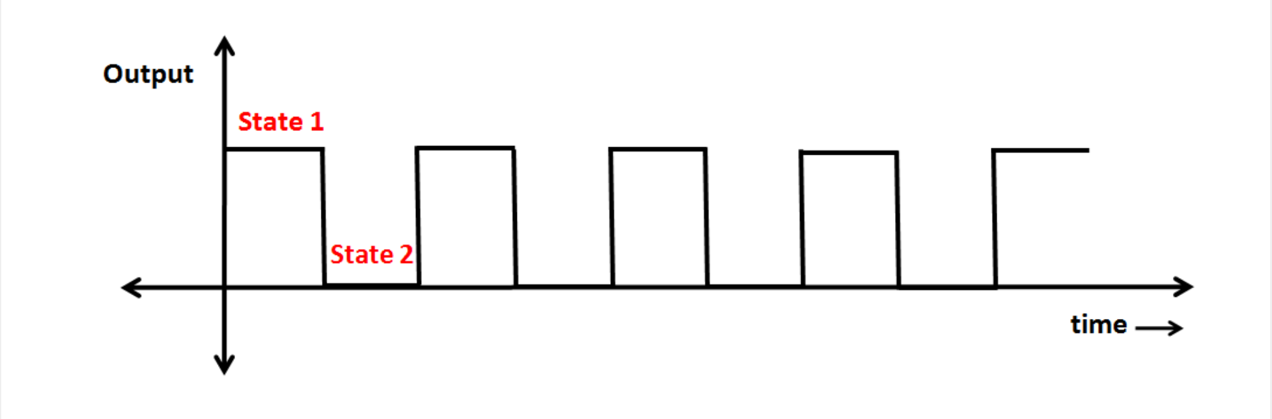

Astable Multivibrator Output

Slide 3
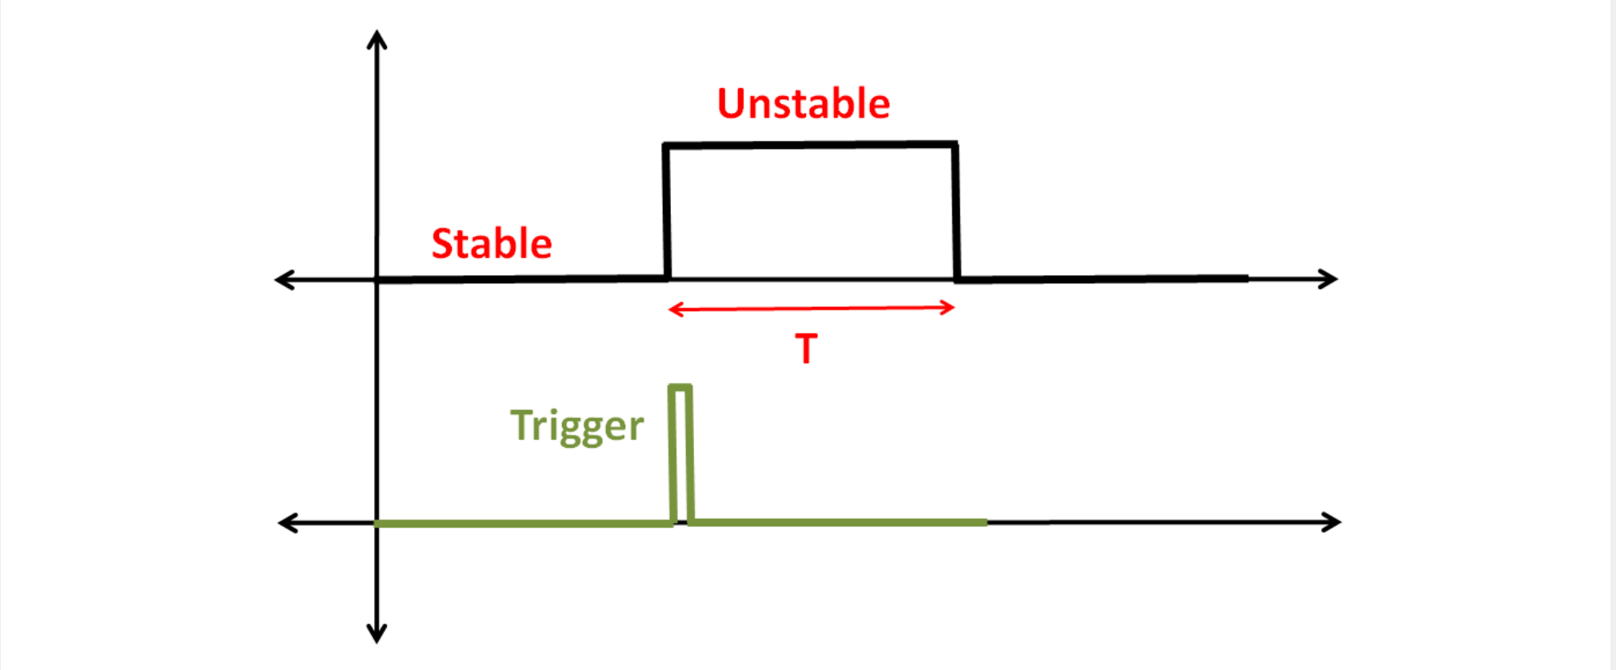
Monostable Multivibrator Output

Slide 4
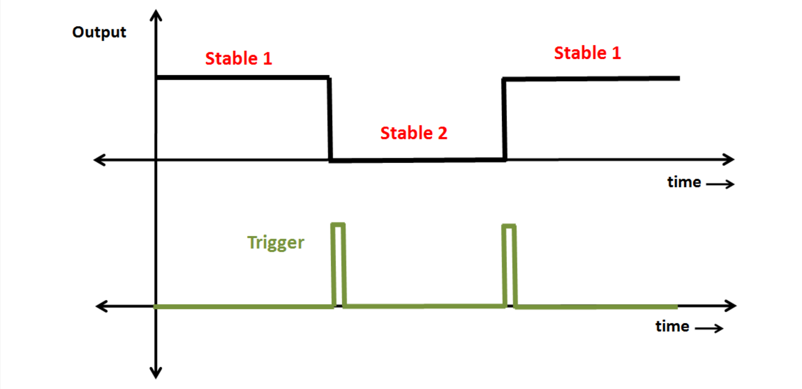
Bistable Multivibrator Output

Slide 5
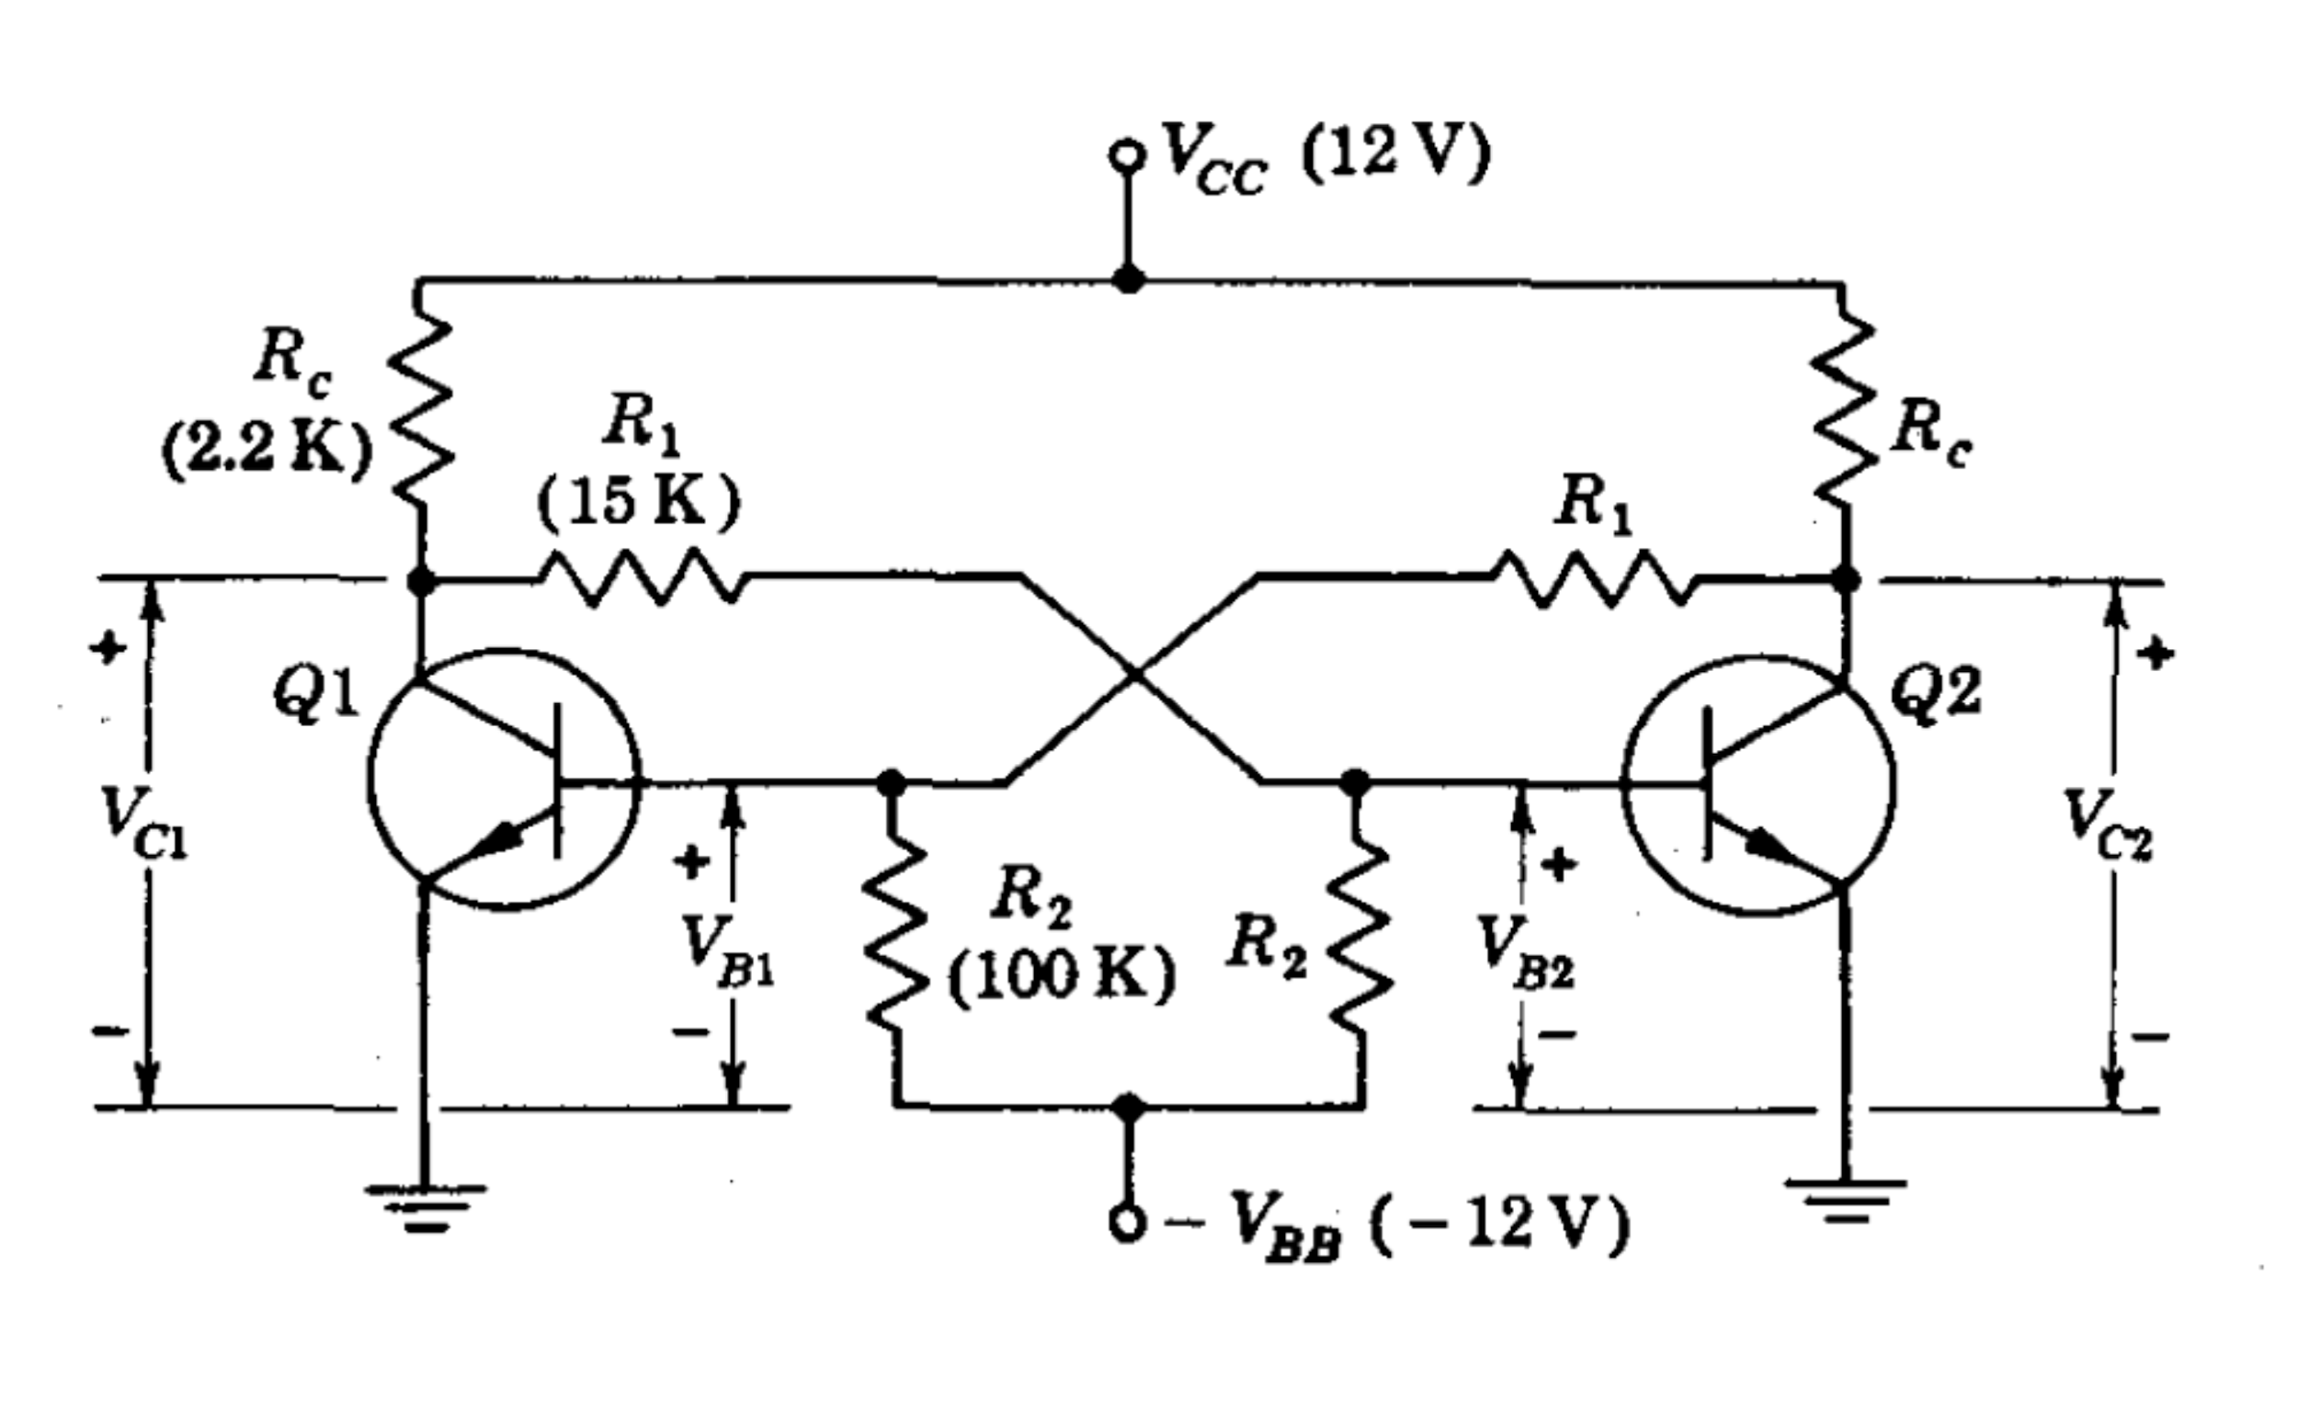
Fixed Bias Transistor Binary

Slide 6
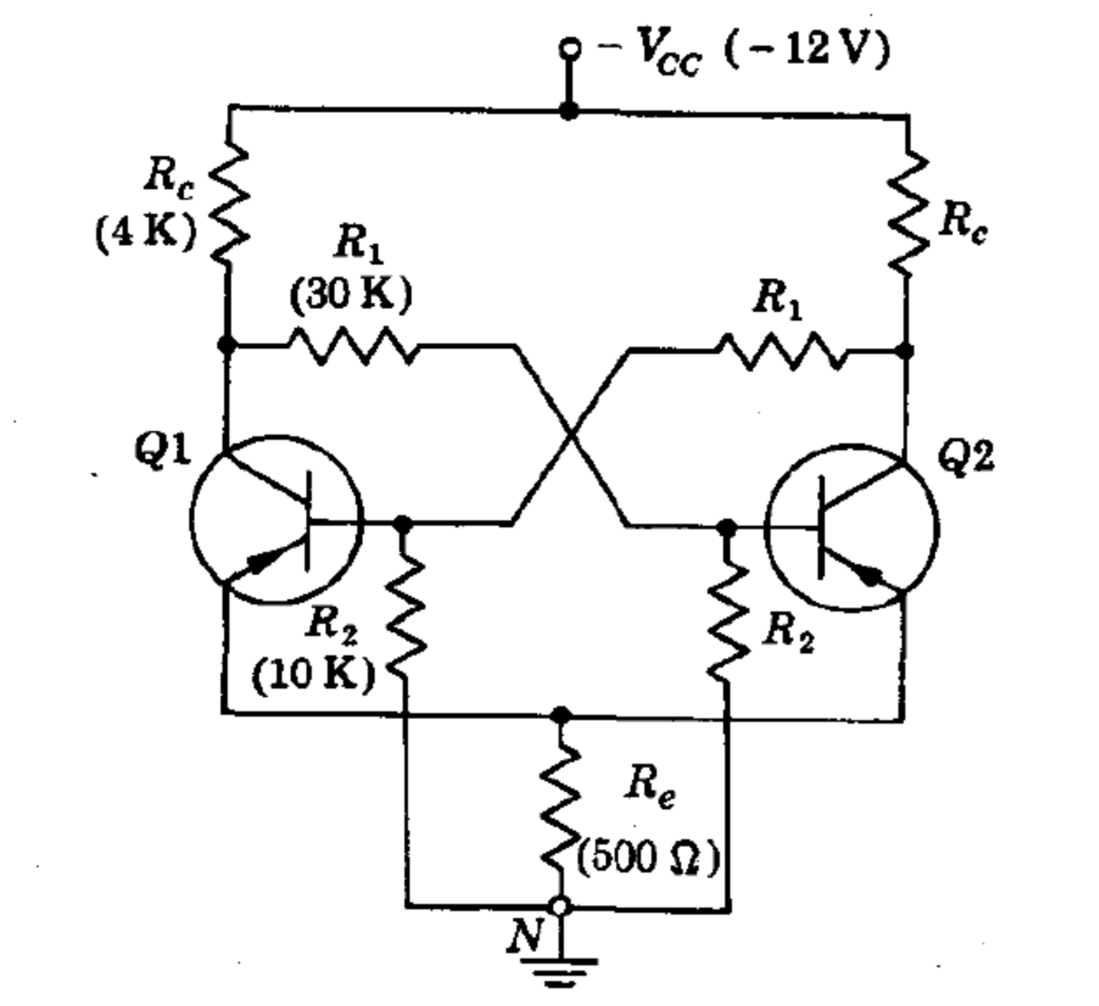
Self-Biased Transistor Binary

Slide 7
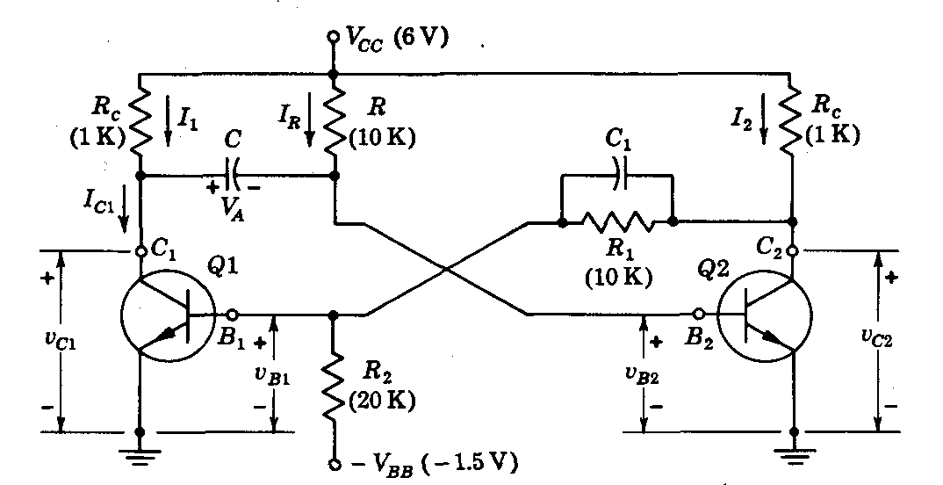
Collector Coupled Monostable Multi

Slide 8
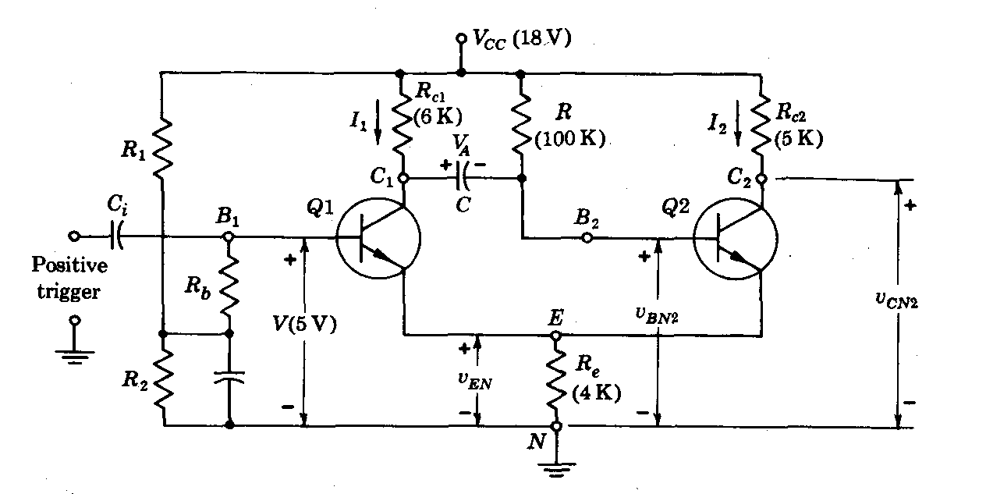
Emitter Coupled Monostable Multi

Slide 9
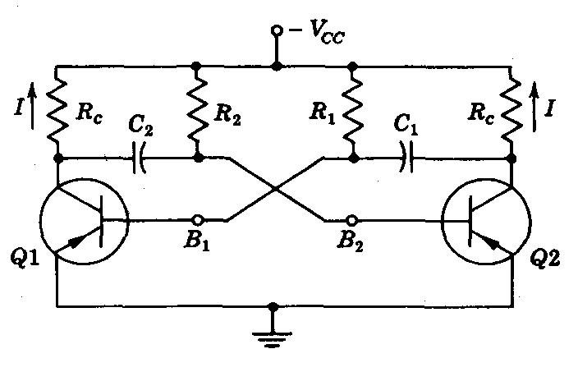
Collector Coupled Astable Multi

Slide 10
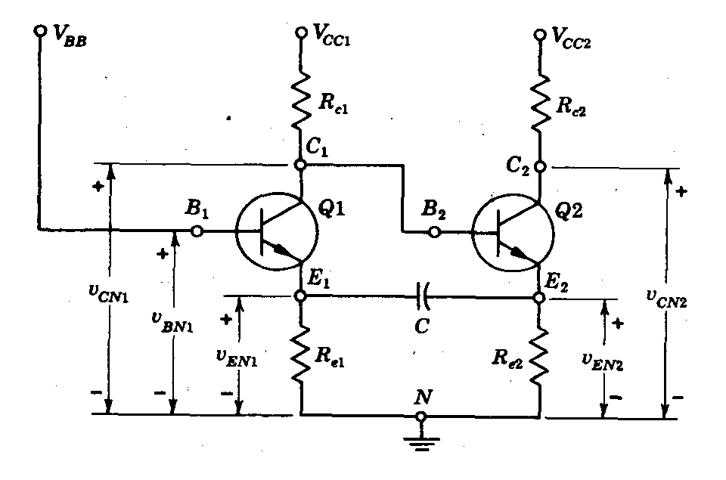
Emitter Coupled Astable Multi

Slide 11
There are no incurable diseases - only the lack of will. There are no worthless herbs - only the lack of knowledge.
Ibn Sina

